Slide 1

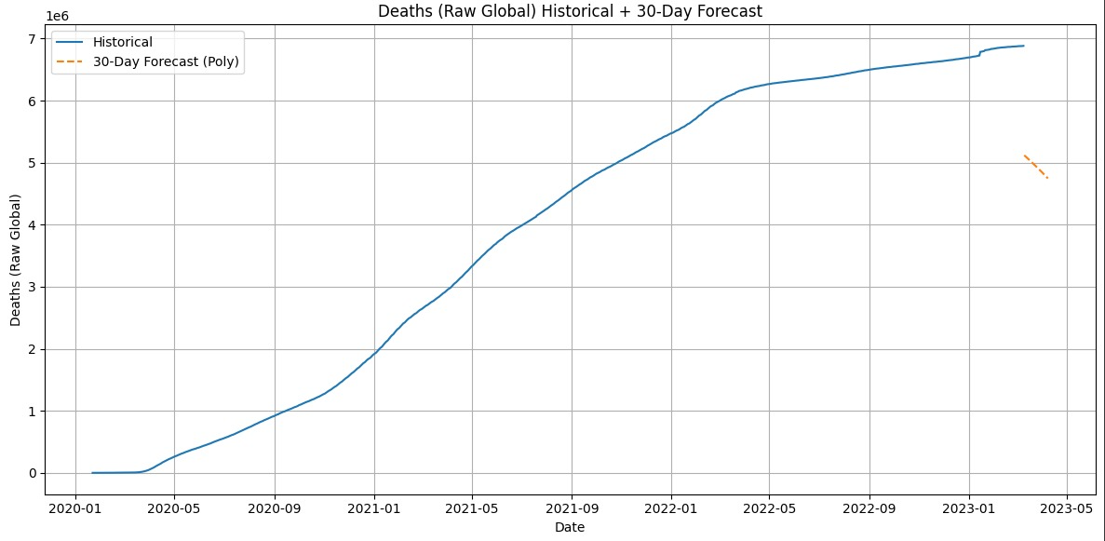
Forecasting COVID-19 Cases: A Time-Series Prediction Model
GROUP NO. - 02
GROUP MEMBERS
Manish Kumar(202401100300149)
Prateek Baliyan(202401100300177)
Mukesh Chauhan(202401100300158)
Prithvi Nawadiya(202401100300183)
Manav Mishra(202401100300148)

Slide 2

Introduction
This presentation outlines the methodology, analysis, and results of a time-series prediction model for forecasting future COVID-19 cases using historical data.
1.Pandemic Impact
Covid 19 challenged health sydtem worldwide dramatically
2.Forcast Importance
Accurate case prediction guide resource planning and response
3 . Our Project Goul is to use time series and regrssion to forecast future COVID 19 cases.

Slide 3

Problem Statement
1.Pediction Challenges – Infectious spread is dynamic and influenced by many factors
2.Model Limitation – Early forecast failed to capture variant impacts accurately
3.Modelling Needs and Resources for it – Robust , adaptive time series models improve forecast accuracy

Slide 4
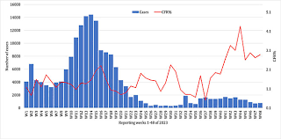
Current COVID-19 Situation
The ongoing COVID-19 pandemic has created an urgent need for accurate forecasting to help manage healthcare resources and implement effective public health measures. Currently, the dominant variant nationwide is LP.8.1, with 70% of cases, followed by XFC, with 9% of cases, and XEC, with 6% of cases. "The original omicron variant is gone now," says Dr. Rupp. "Currently subvariants of omicron are circulating, including MC.1.10.1, LB.1.3.1, and LF.7.“and at this the current moment there is a rapid rise in the number of cases .So ,taking all the steps and prevention is one of the important measures to overcome COVID 19 .

Slide 5

Methodology
The methodology followed in this project involves a structured approach, starting from data collection to model building and evaluation. The steps are as follows:
Data Collection: The user provides the dataset in the form of a CSV (Comma-Separated Values) file. This dataset contains historical COVID-19 case records with various relevant features.
2. Data Preprocessing: To ensure the data is clean and suitable for modeling, the following preprocessing steps are:
performed: Handling Missing Values: Missing data is treated using mean imputation for numerical features and mode imputation for categorical features. Encoding Categorical Variables: Categorical variables are converted into numerical format using one-hot encoding, which helps in applying machine learning models.Feature Scaling: All numerical features are standardized using StandardScaler to ensure uniformity in scale and improve model performance
3. Model Building: After preprocessing, the model is developed using the following steps: Data Splitting: The dataset is divided into training and testing sets to evaluate model performance effectively. Model Training: A Logistic Regression classifier is trained on the processed training data to learn patterns and relationships.

Slide 6
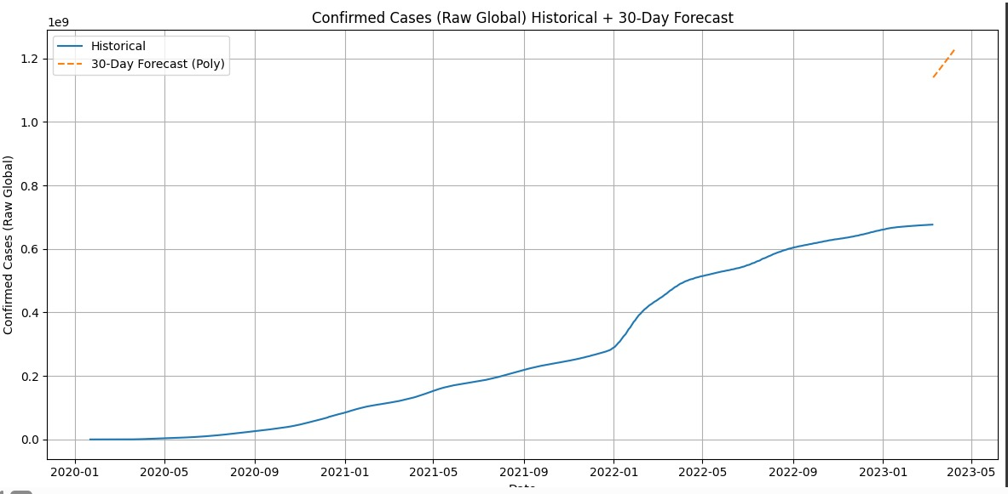
OUTPUT

Slide 7
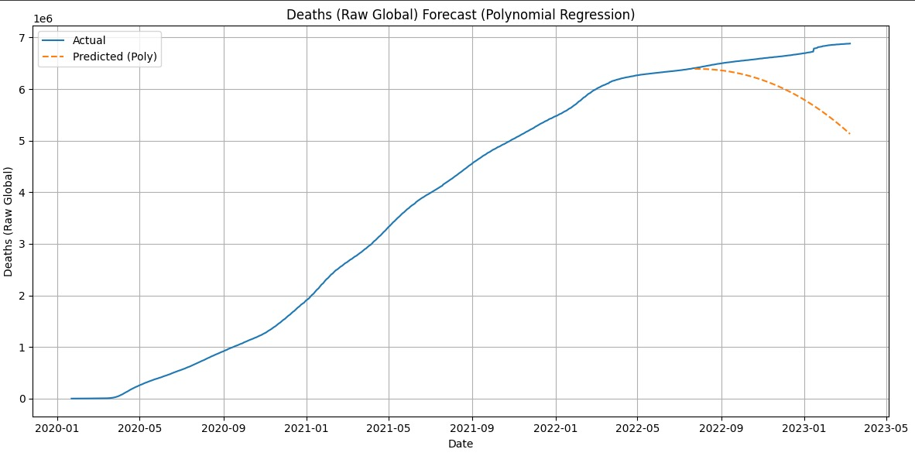

Slide 8
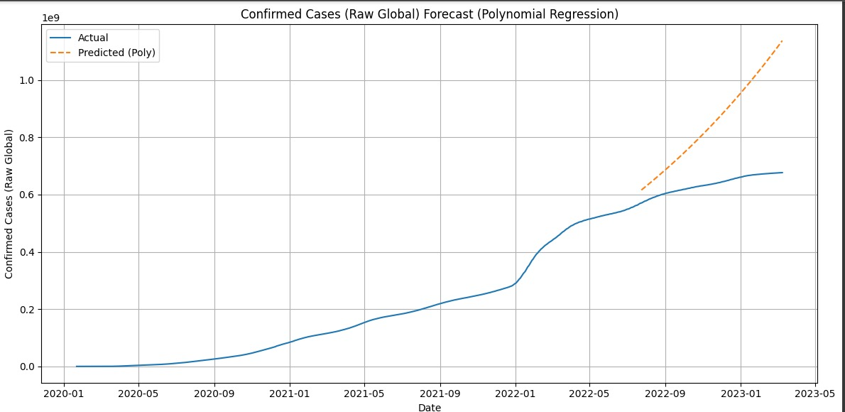

Slide 10
REFERENCES
Link: https://www.kaggle.com/datasets/antgoldbloom/covid19-data-from-john-hopkins-university
https://data.who.int/dashboards/covid19/cases
https://www.worldometers.info/coronavirus/

Slide 11
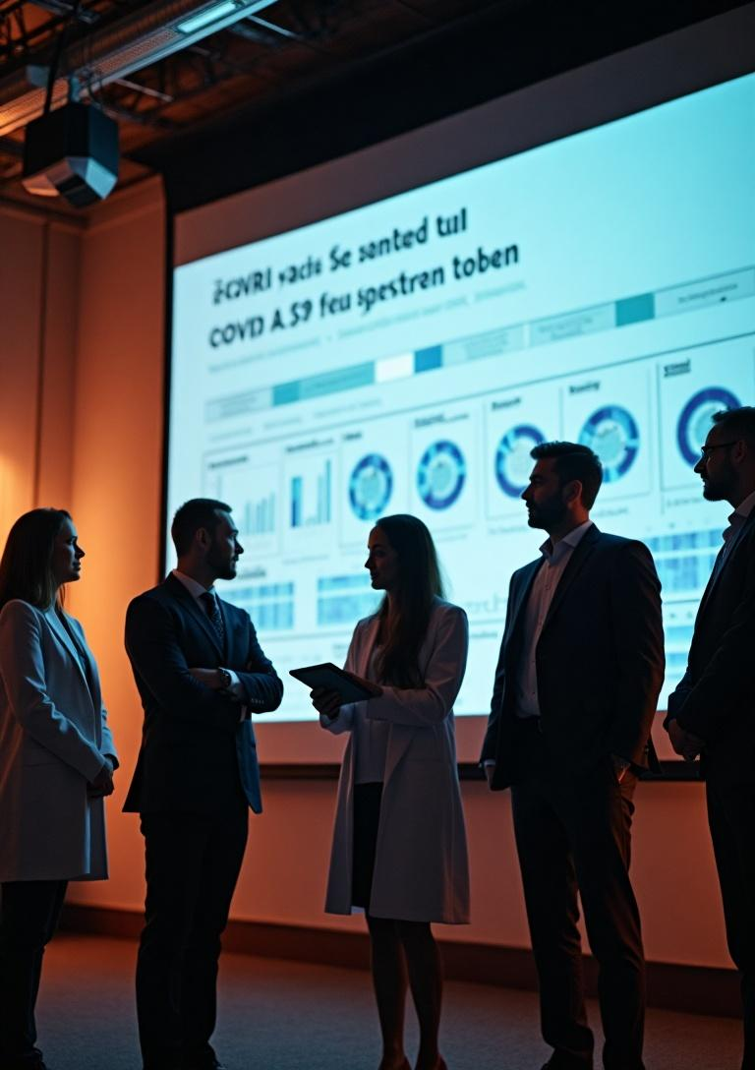
Conclusions
This presentation demonstrated the importance of a robust modeling approach for forecasting COVID-19 cases. Through careful data analysis, model selection, and evaluation, we can derive actionable insights that contribute to effective pandemic response strategies.

Slide 12
THANK YOU!

